Slide 1
DATA ANALYTICS
BUSINESS PROPOSAL -SUPERSTORE
BY
ANANYA MANOJ - TEAM 3

Slide 2
TEAM 3-MEMBERS
Ananya Manoj – Descriptive Analysis.
Harini K – Diagnostic Analysis.
Maghalakshmi R – Prescriptive Analysis.
Nandhini Devi M – Location Analysis.
Nithiyasri S – Cost Analysis.
Praveen R – Predictive Analysis.

Slide 3
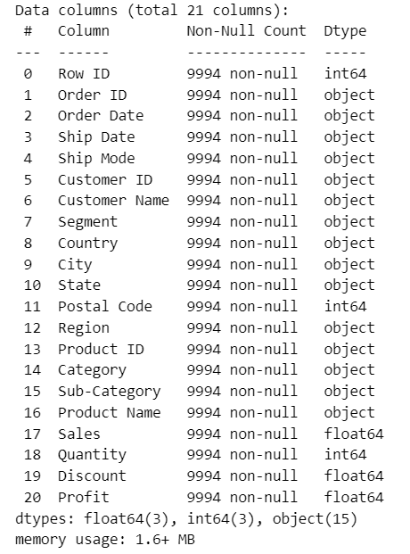
OVERVIEW
INTRODUCTION
Super Store is a small retail business located in the United States. They sell Furniture, Office Supplies and Technology products and their customers are the mass Consumer, Corporate and Home Offices.
Our task is to analyse the sales data and identify weak areas and opportunities for Super Store to boost business growth.
DATASET
This dataset provides comprehensive view of the sales transactions, products, customers, discount, and geographical details.

Slide 4
DESCRIPTIVE ANALYSIS
Descriptive analysis is a preliminary exploration of the data that focuses on summarizing and presenting information in a meaningful way. It involves the use of statistical measures, visualizations, and descriptive statistics to reveal patterns and characteristics within the data.
OBJECTIVE
Summary statistics
Customer segmentation
Total sales by Category
Total sales by Sub-Category
Product-wise analysis
City-wise analysis and discount distribution

Slide 5
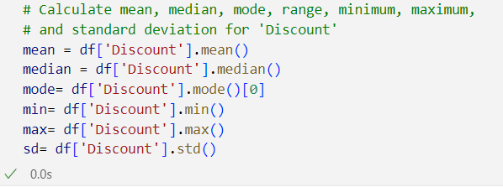
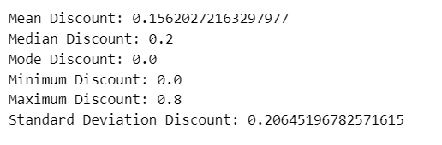
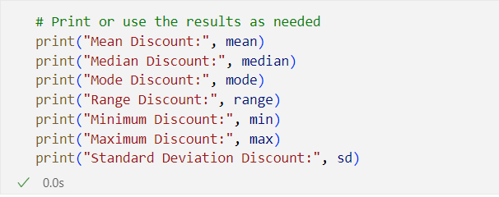
SUMMARY STATISTICS
PYTHON
Calculating mean, median , minimum, maximum and standard deviation for discount.
OUTPUT

Slide 6
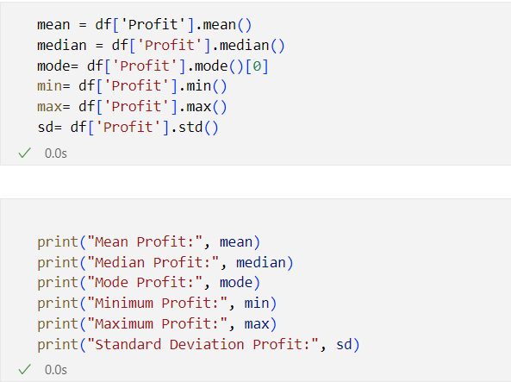
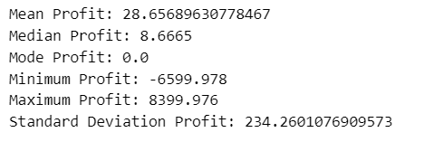
SUMMARY STATISTICS
Calculating mean, median , minimum, maximum and standard deviation for profit.
OUTPUT

Slide 7
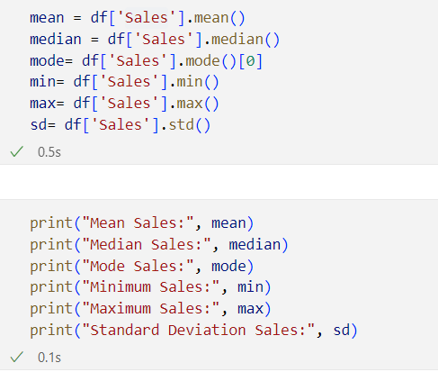
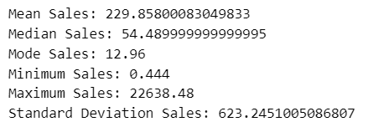
SUMMARY STATISTICS
Calculating mean, median , minimum, maximum and standard deviation for sales.
OUTPUT

Slide 8
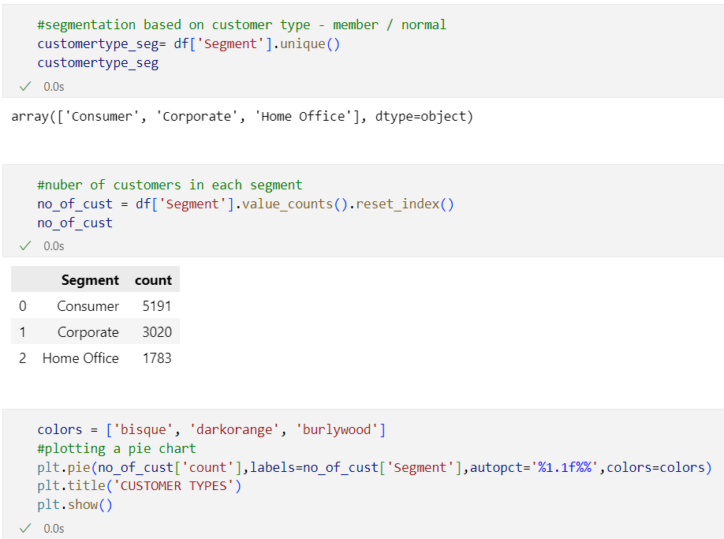
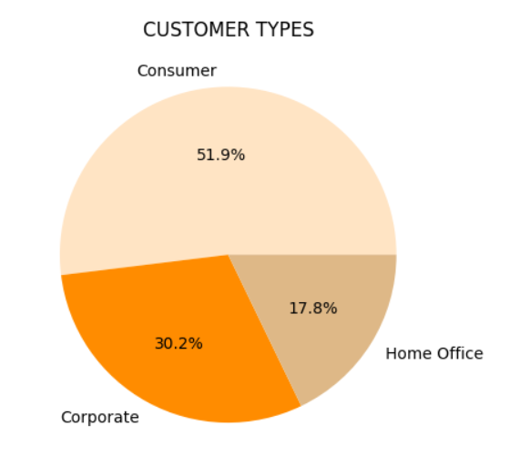
CUSTOMER SEGMENTATION
INTERPRETATION
The largest segment is "Consumer," constituting 51.9% of the customer base.
The "Corporate" segment is also substantial, comprising 30.2% of the customer base.
The "Home Office" segment, while smaller compared to the other two, still holds a significant portion at 17.8%.
INFERENCE
A significant portion of the customer population falls under the consumer category.
This indicates that there is a notable presence of corporate customers, potentially representing businesses and organizations.

Slide 9
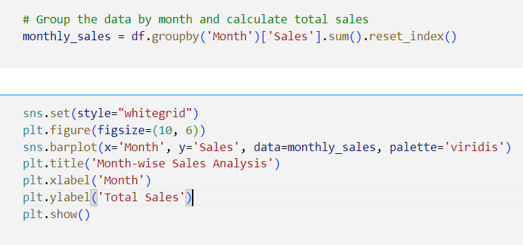
MONTH-WISE SALES ANALYSIS
IMPLEMENTATION
INTERPRETATION
The largest sales has happened during the month February "Consumer," constituting 51.9% of the customer base.
The "Corporate" segment is also substantial, comprising 30.2% of the customer base.
The "Home Office" segment, while smaller compared to the other two, still holds a significant portion at 17.8%.
INFERENCE
A significant portion of the customer population falls under the consumer category.
This indicates that there is a notable presence of corporate customers, potentially representing businesses and organizations.

Slide 10
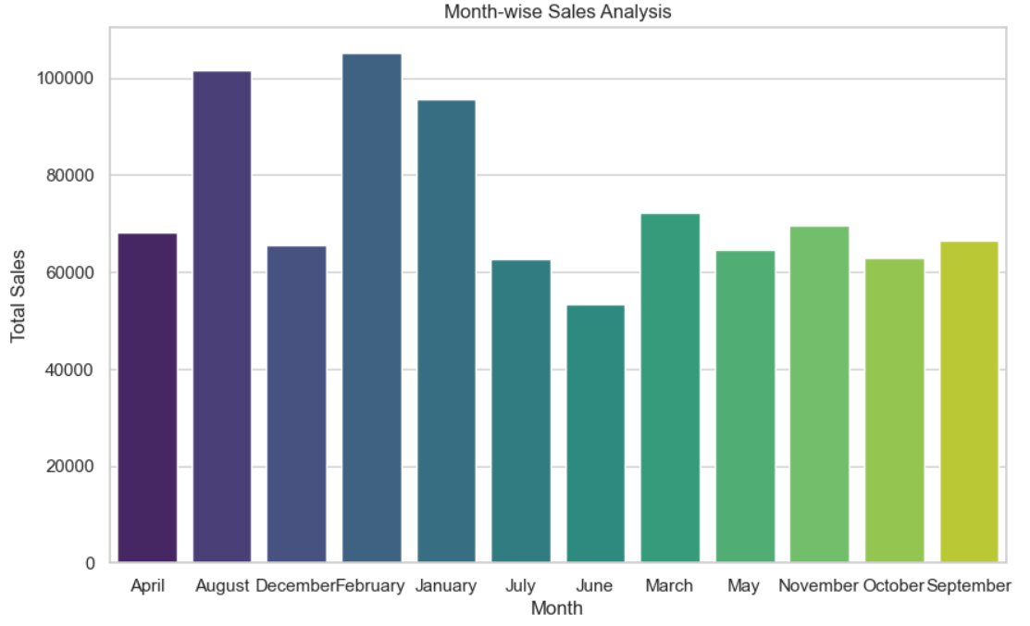
MONTH-WISE SALES ANALYSIS

Slide 11
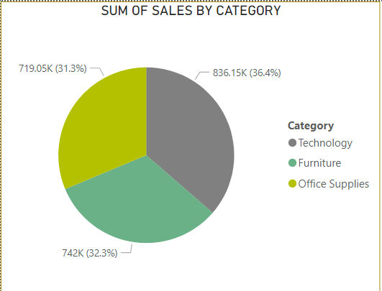
TOTAL SALES BY CATEGORY
USING POWER BI
INTERPRETATION
Technology products contributed the highest to total sales, reaching 836.15K.
Furniture sales amounted to719.05K, indicating a substantial contribution to overall revenue.
Office supplies made a significant impact on sales, totaling 742K.
INFERENCE
The high contribution from the "Technology" category suggests that the company's strategy in offering electronic devices and gadgets is successful.
The significant impact of "Office Supplies" on sales highlights the importance of catering to business and office-related needs.
Analyzing the sales distribution provides insights into customer behavior.

Slide 12
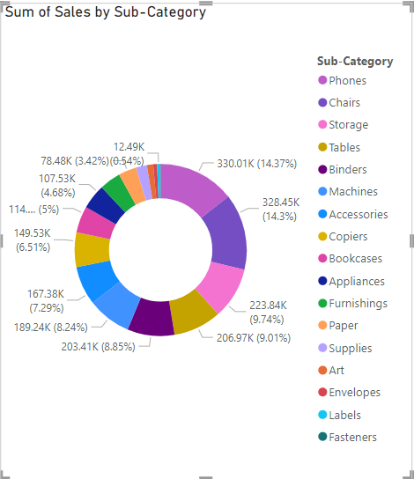
TOTAL SALES BY SUB-CATEGORY
INTERPRETATION
The categories "Phone," "Chair," and "Storage" have recorded the highest sales.
The categories "Labels," "Fasteners," and "Envelope" have the least sales. These products may have lower demand compared to others, possibly considered as supplementary or non-essential items.
INFERENCE
The high sales in categories like "Phone," "Chair," and "Storage" suggest strong market demand for technology and furniture products.

Slide 13
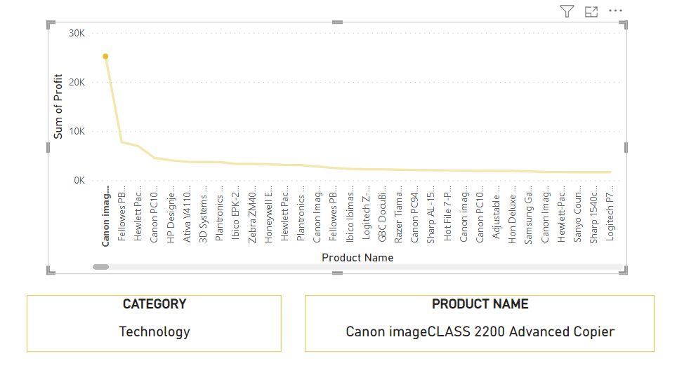
PRODUCT WISE ANALYSIS
INTERPRETATION
Canon imageClass 2200 Advanced Copier contribute most to the overall profitability of the business.
The Furniture “Cubify CubeX 3D Printer Double Head print ” has the least.

Slide 14
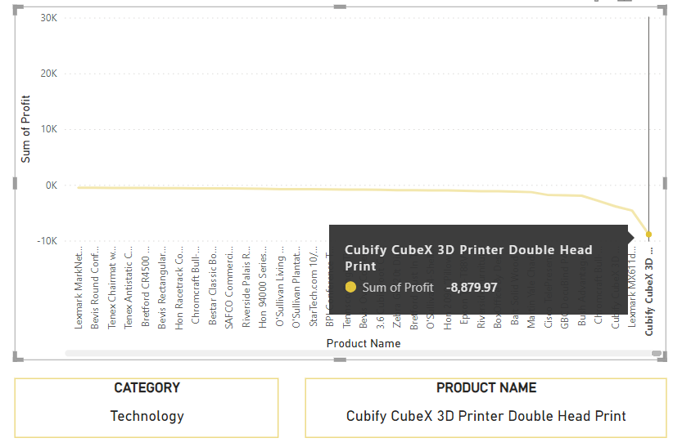
PRODUCT WISE ANALYSIS
INFERENCE
The Canon imageClass 2200 Advanced Copier high contribution to overall profitability suggests that it is a popular and lucrative product.
The Cubify CubeX 3D Printer may not align as well with customer needs or preferences, impacting its market performance.

Slide 15
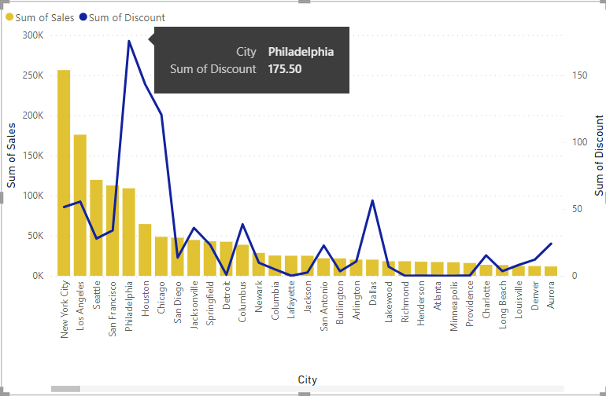
CITY-WISE SALES AND DISCOUNT DISTRIBUTION

Slide 16
INTERPRETATION
New York city has the highest sales.
Philadelphia’s has higher discount rates.
INFERENCE
The differing sales and discount patterns may indicate distinct market segments in each city.
New York City, being a major economic hub, may have a higher population density and greater purchasing power, contributing to higher overall sales.
In Philadelphia, the higher discount rates might suggest a focus on price-sensitive consumers or a strategy to stimulate sales.

Slide 17
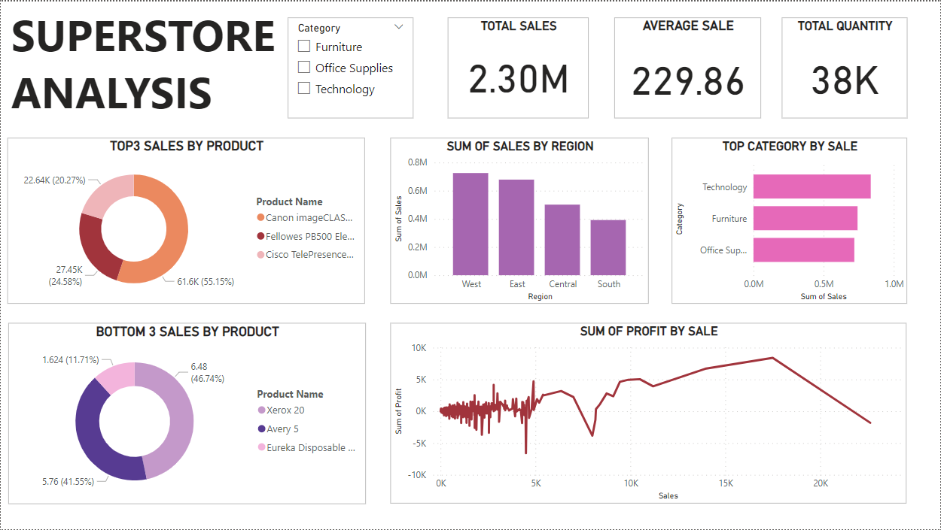
USING POWER BI

Slide 18
REFERENCE
https://youtu.be/NNSHu0rkew8?si=ga-4zuWVk-y77W85
https://www.analyticsvidhya.com/blog/2021/06/complete-guide-to-data-types-in-statistics-for-data-science/
https://learn.microsoft.com/en-us/power-bi/create-reports/sample-retail-analysis
https://matplotlib.org/cheatsheets/

Slide 19
THANK YOU

